Slide 1
Chapter 2 Objectives
The CCNA Topics Covered in this chapter include:
  What is Static NAT?
  Configuration of static NAT
  Working example of static NAT

Slide 2
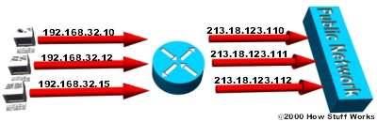
Static NAT
Static NAT - Mapping an unregistered IP address to a registered IP address on a one-to-one basis. Particularly useful when a device needs to be accessible from outside the network.
In static NAT, the computer with the IP address of 192.168.32.10 will always translate to 213.18.123.110.

Slide 3
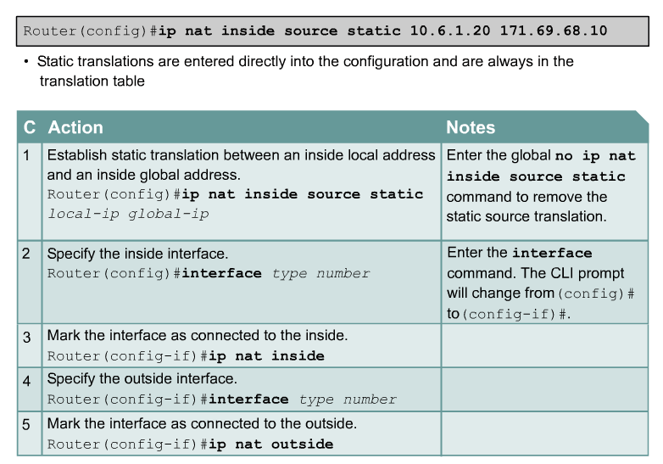
Static NAT

Slide 4
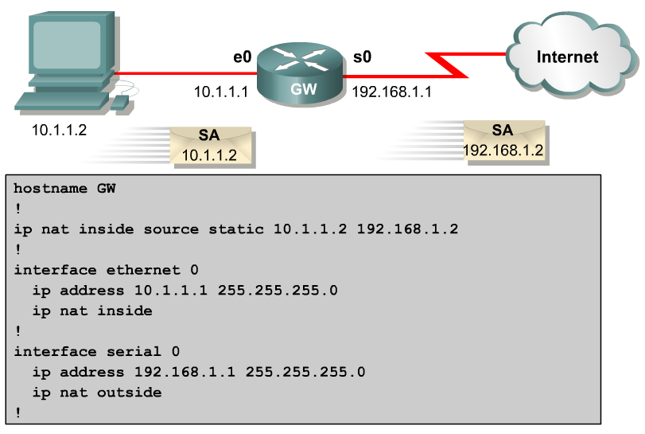
Configuring Static NAT

Slide 5
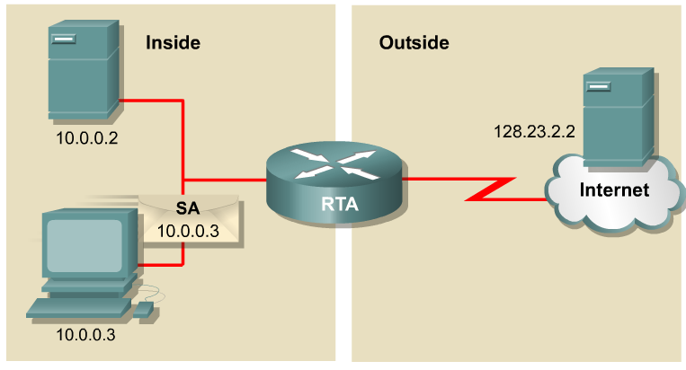
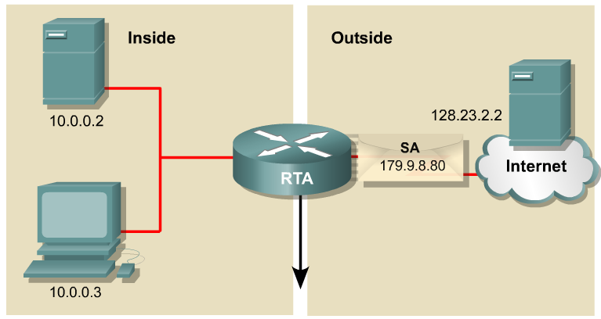
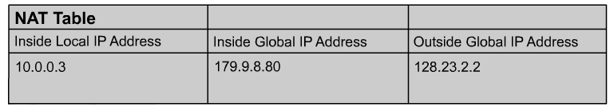
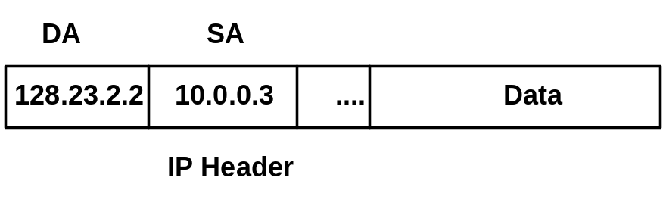
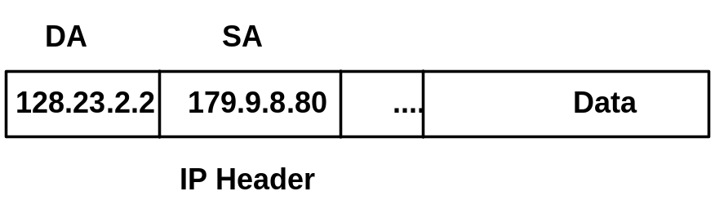
NAT Example
1
2
1
2
The translation from Private source IP address to Public source IP address.

Slide 6
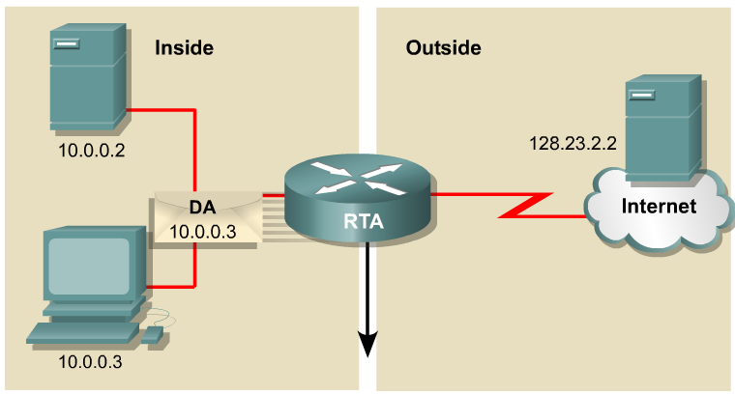
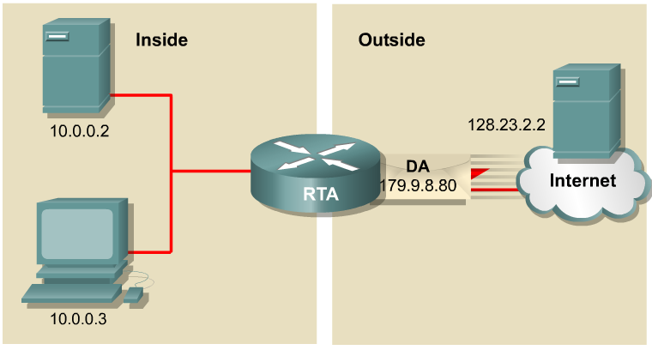
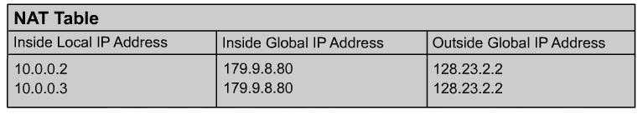
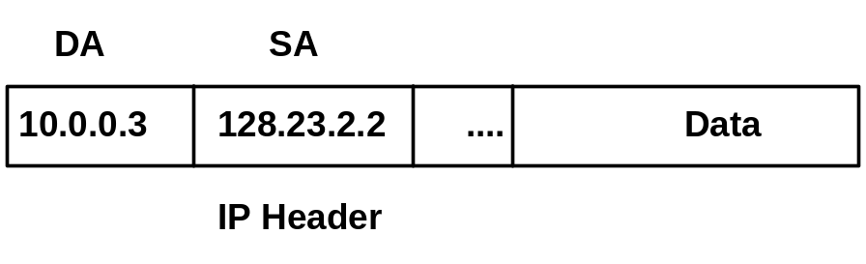
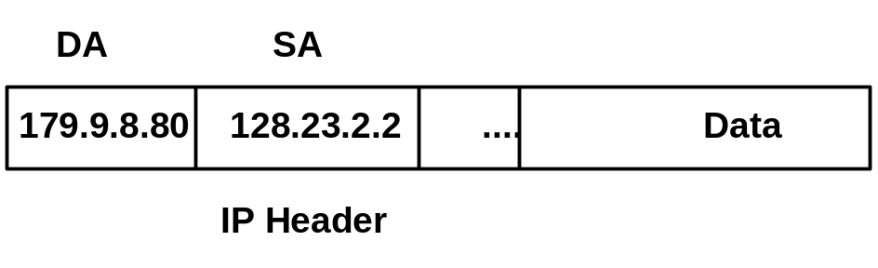
NAT Example
4
3
4
3
Translation back, from Public destination IP address to Private destination IP address.

